Slide 1


Pandas library
DATA ANALYTICS BOOTCAMP | IRONHACK

Slide 2



Checking data types
NEVER
NEVER
NEVER
NEVER FORGET TO CHECK DATA TYPES!!!
00

Slide 3
Checking data types
Pandas not always understand correctly the data type of each column.
Use the method: info()
data.info()
A bad data type will ruin your model!!!
Why?

Slide 4
Data types
The main types of Pandas are:
int ( integers number )
float ( number with decimals )
object ( categorical )
strings ( sets of characters )
date_time
How we select columns of one give type? Using the method: select_dtypes() on your dataframe
data.select_dtypes('object')
Pandas data types for Data Analytics
00

Slide 5
Data types
The main method to convert a column to another data type is: astype()
df[ column_name ].astype(new_type)
Type conversion methods
00

Slide 6
Data types
ALWAYS check for duplicates in your datasets.
They don’t add information
They can bias your model
They increase the time to train a model
Use the method: drop_duplicates()
data.drop_duplicates()
Dropping duplicates
00

Slide 7
Data types
To get a first expiration of your dataframe (df), you can use: df.head()
To have an idea of range of values for each numerical columns use: df.describe()
To get a glimpse of the same for ‘object’ columns use: df[‘colname’].value_counts()
To get unique values: df[‘colnames’].unique()
Exploring the dataframe
00

Slide 8
Pandas wrangling/cleaning
To select a given column name:
df.column_name
df[ list_of_column_names ]
To select a row:
df.iloc[ list_of_row_indexes ]
To select a subset of rows/columns:
df.iloc[ list_if_row_indexes,
list_of_column_indexes ]
Subsetting
00

Slide 9
Pandas wrangling/cleaning
To filters rows/columns based on condition simply insert the condition within the brackets:
df[condition]
To combine several conditions, place each within parentheses and combine them using
& (and)
| (or)
Filters
00

Slide 10
Pandas wrangling/cleaning
To drop columns/rows from a Pandas dataframe, use the method: drop()
For columns:
df.drop(columns=’column_name', inplace=True)
For rows:
df.drop(list_of_row_indexes, inplace=True)
Dropping columns/rows
00

Slide 11
Pandas wrangling/cleaning
We can have access to our dataframe using “indexes” (ie, row and/or column index)
In order to do so, we need to use the method: iloc[]
The: .iloc[] method can have one or two slots
df.iloc[1:3]
# now, working just on the indexes row,columns
df.iloc[1:10,0:4]
df.iloc[[1,2,3,4],[0,2,4]]
Indexes
00

Slide 12
Pandas wrangling/cleaning
Dropping rows doesn’t reset the indexes!!!.
There is a method to reset them: reset_indexes()
https://pandas.pydata.org/pandas-docs/stable/reference/api/pandas.DataFrame.reset_index.html
Indexes
00

Slide 13
Pandas wrangling/cleaning
To reorder the columns, simply provide within the brackets a list with the new column name order:
df[ list_of_columns ]
Reordering columns
00

Slide 14
Working with columns
In order to find missin_values Pandas provides the methods:
isna()
isnull()
Both methods carry out the analysis column_wise (ie. reports the results for each element of each column)
To know how many missing values are in each column you can “append” the method: sum() to the previous method.
To compute the percentage of missing values....?
Finding missing values
00

Slide 15
Missing values
Keep track of columns names and the percentage of missing values in each.
You can create a Dataframe to store the previous info! (ie: null_df) with:
pd.Dataframe()
round(data.isna().sum()/len(data),4)*100 # shows the percentage of null values in a column
nulls_df= pd.DataFrame(round(data.isna().sum()/len(data),4)*100)
nulls_df
nulls_df = nulls_df.reset_index()
nulls_df
nulls_df.columns = ['header_name', 'percent_nulls']
Nulls_df
columns_drop = nulls_df[nulls_df['percent_nulls']>3]['header_name'] # dummy case with 3
print(columns_drop.values)
Finding missing values
00

Slide 16
Missing values
To achieve this, Pandas provides the method: fillna() to be applied to an specific column of the dataset.
It needs the value to replace the “na” as an argument.
data['median_home_val']= data['median_home_val'].fillna(mean_median_home_value)
With categorical column types, you can get how many values you have of each applying the method: value_counts() to the corresponding column
Filling NA’s
00

Slide 17
Aggregation
The aggregation operation consists in making computations by groups.
To create aggregations you can use df.groupby(column)
To specify the aggregation function append it at the end of the groupby. Ex:
df.groupby(‘gender’).count()
If a list of columns is provided to groupby, then the aggregation will take place in the same hierarchical order of columns. Ex
df.groupby([‘state’,’gender’]).count()
In this last case a “multiindex” dataframe is generated . To prevent this use the option ‘as_index=False’
Aggregation by groups
00

Slide 18
Joins
Several dataframes, can be combined based on a common column.
There are four different types of joins:
Inner join
Left join
Right join
Full join
Joins
00

Slide 19
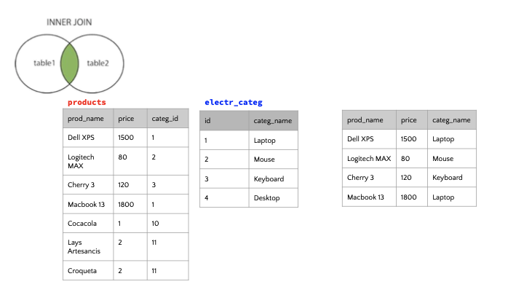
Joins
This type of join merge the common records in BOTH tables
00

Slide 20
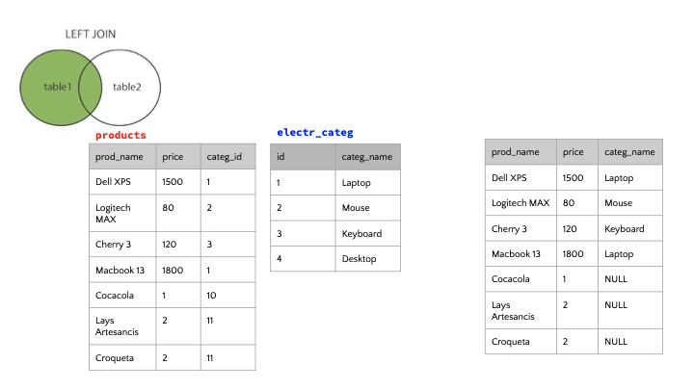
Joins
This type of join combines the info about the records of both tables regardless if there is a match in the RIGHT table.
Joins
00

Slide 21
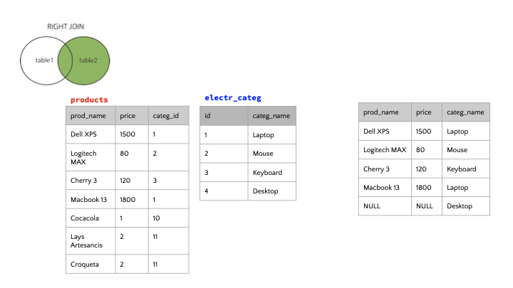
Joins
This type of join combines the info about the records of both tables regardless if there is a match in the LEFT table.
Joins
00

Slide 22
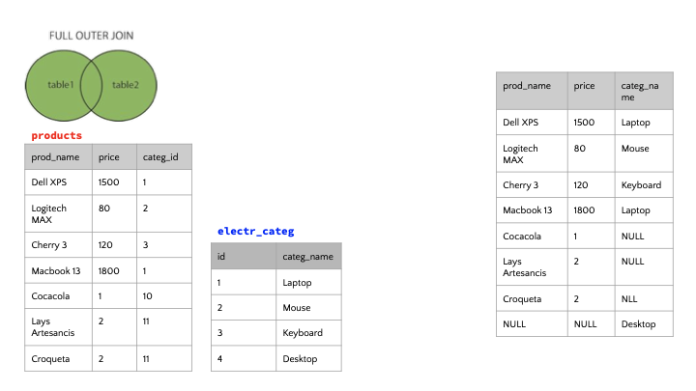
Joins
This type of join combines the info about the records of BOTH tables.
Joins
00

Slide 23
Joins
Concat method combines dataframes matching the indexes of both dataframes by default.
Joins can be implemented using the option “join=type_of_join” in the “concat” method”
Joins
00

Slide 24
Melt
Melt
Melting a dataframe consists displaying some columns as rows.
00

Slide 25
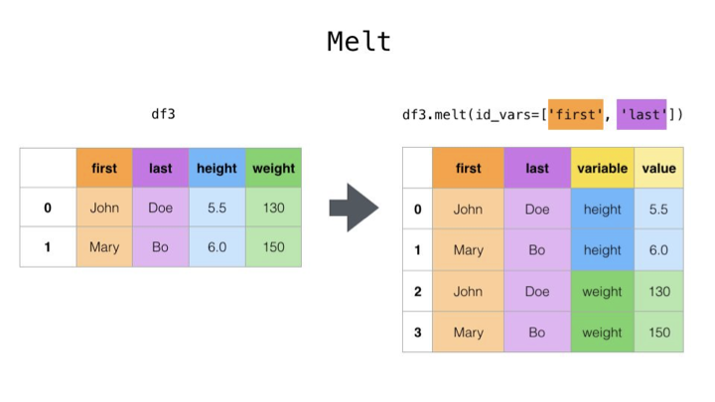
Melt
00

Slide 26
Pivoting
Pivoting
Pivoting is just the opposite operation of melting.
df.pivot(index=’col1’, columns=’col2’)
00

Slide 27


